Slide 1

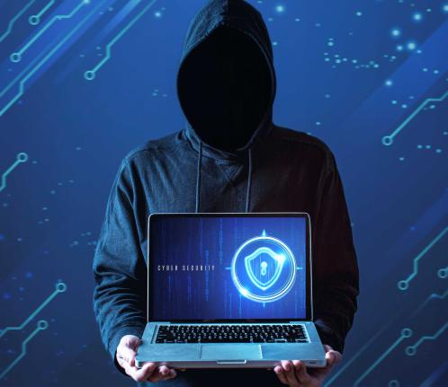
Bruce Industries: Incident Response Focusing on
Digital Forensics

Slide 2

Organization Background
Bruce Industries:
A globally recognized and leading VLSI (Very-Large-Scale Integration) design and semiconductor manufacturing firm.
With decades of innovation and excellence, the company specializes in evolving proprietary chip blueprints and pioneering microarchitecture designs.
Serve as the advancements for next-generation of computing technologies.
To fight with the increasing threat of cyber-espionage and sensitive assets, company implemented TLS system also known as SSL proxy to inspect internal HTTPS traffic for some malware or data exfiltration.
FORENSICS

Slide 3

Incident Overview
Internal monitoring systems flagged unusual activity originating from a server used by the HR department.
The system was known to handle encrypted archives containing sensitive employee information.
The nature of the alerts prompted the security team to escalate the issue to Incident Response and Digital Forensics teams.
No immediate external breach was confirmed, but early signs warranted a closer look.

Slide 4






Incident Response Planning
Identify and confirm the security incident
Contain the threat to prevent further damage
Eradicate malicious activity from affected systems
Recover systems and resume normal operations
Learn from the incident to improve future defenses Here we're focusing more on Forensics side

Slide 5

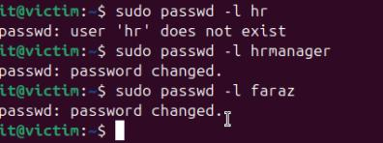
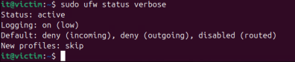
Containment
Containment is the process of limiting the impact of a security incident before it spreads further. Disconnecting a compromised device from the network.
Blocking malicious IP addresses or domains.
Disabling user accounts such as HR account and IT admin of that machine.
Redirecting traffic or changing firewall rules.

Slide 6
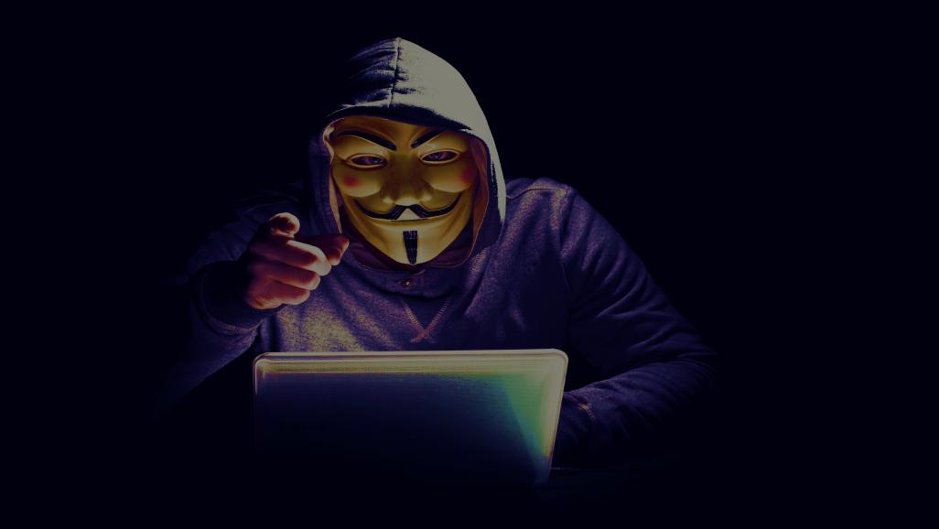
Observed Exploitation Pattern
Initial access was gained through a web-based vulnerability introduced into the HR portal.
The attacker escalated privileges using misconfigured local permissions and accessed sensitive directories.
Final actions involved data exfiltration through a covert channel, bypassing traditional alerting mechanisms.
Packet captures and protocol analysis provided step-by-step evidence of the entire attack flow.
The investigation uncovered a multi-step exploitation process, each action building on the previous one.

Slide 7
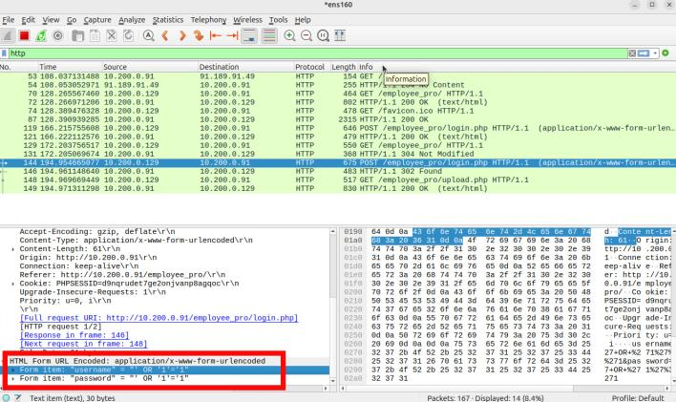
SQL Injection

Slide 8
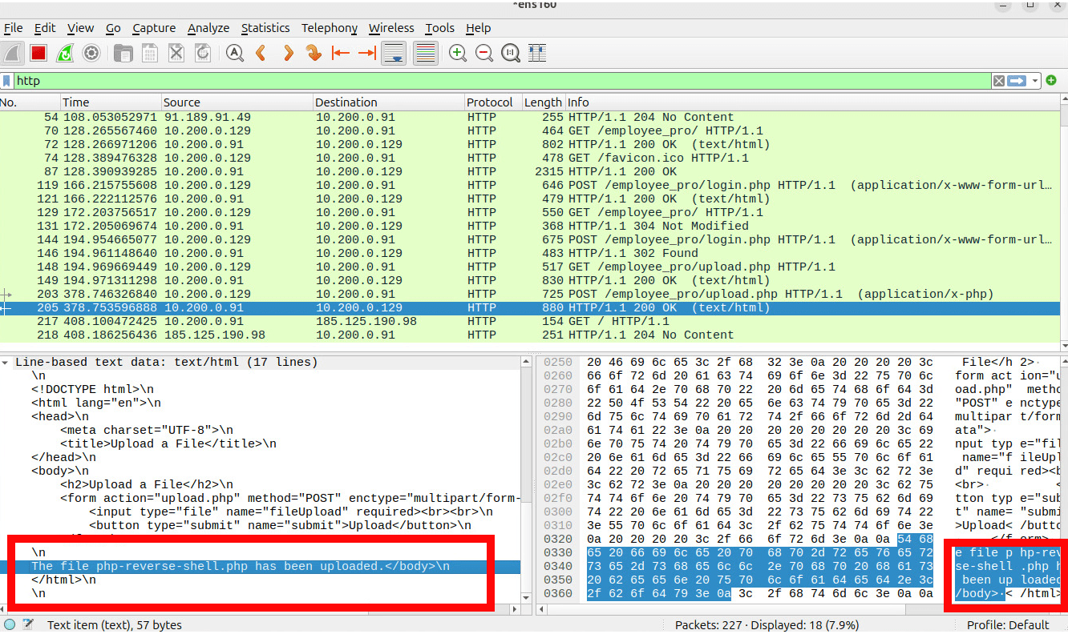
RFI File Upload

Slide 9
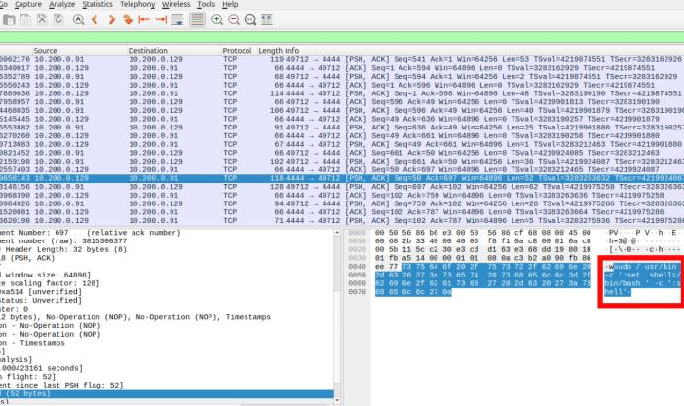
Exploiting VIM sudo vulnerability

Slide 10
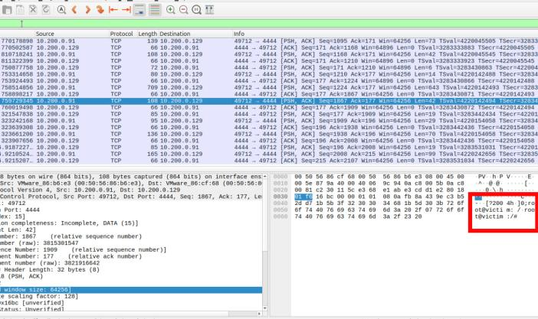
Root Access at Victim Machine

Slide 11
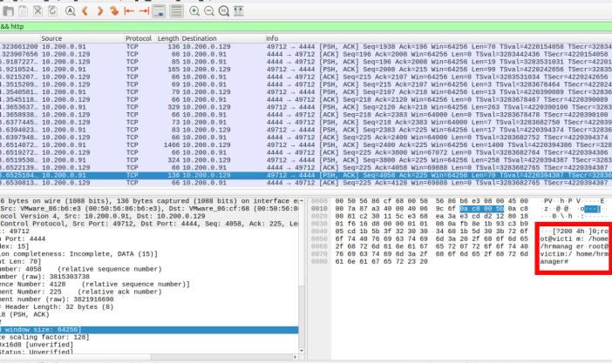
Attacker Reconnaissance Within HR Directory

Slide 12
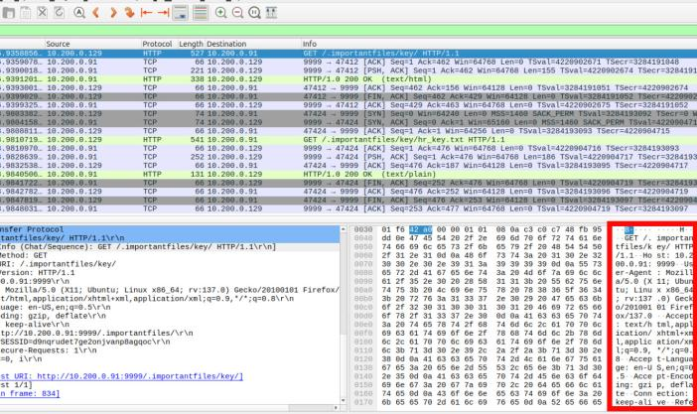
Attacker exfiltrating data through Python Server

Slide 13

What's Next? Lessons Learned?
Any Questions?

Slide 14

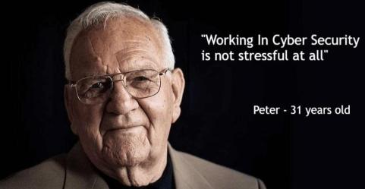
Peter – 20 years
old
Peter with data

Slide 15
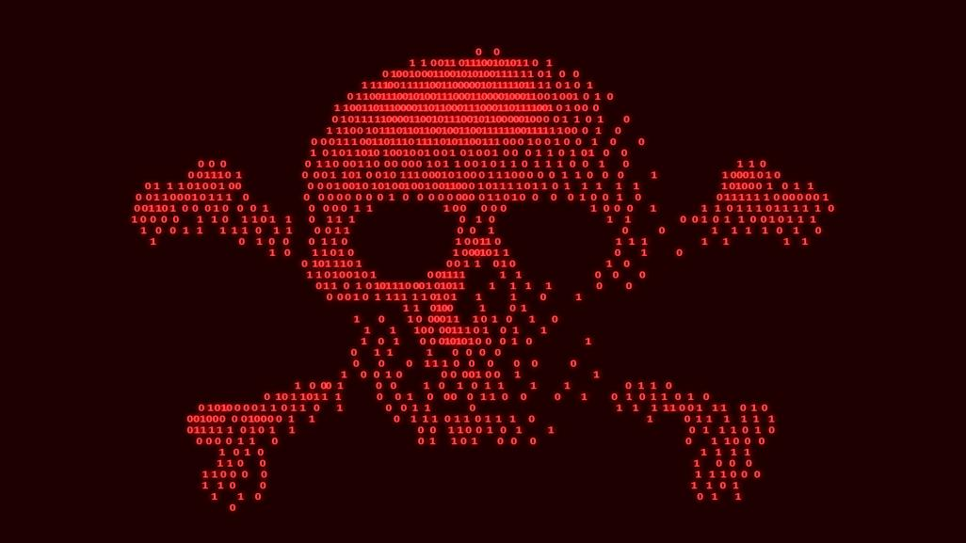
Red Flags in Vulnerability Pattern
During initial analysis, forensic investigators observed a suspicious pattern
Multiple critical vulnerabilities were present on the same system:
SQL Injection in HR web portal
Remote File Inclusion (RFI) upload capability
Privilege escalation via sudo misconfiguration (vim NOPASSWD for daemon)
This combination felt unusual and intentional, not accidental.
Decision was made to perform deep-dive forensic analysis on the full disk image of the machine to identify potential insider involvement.
Truths are yet to be uncovered...

Slide 16
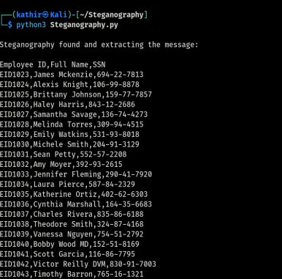
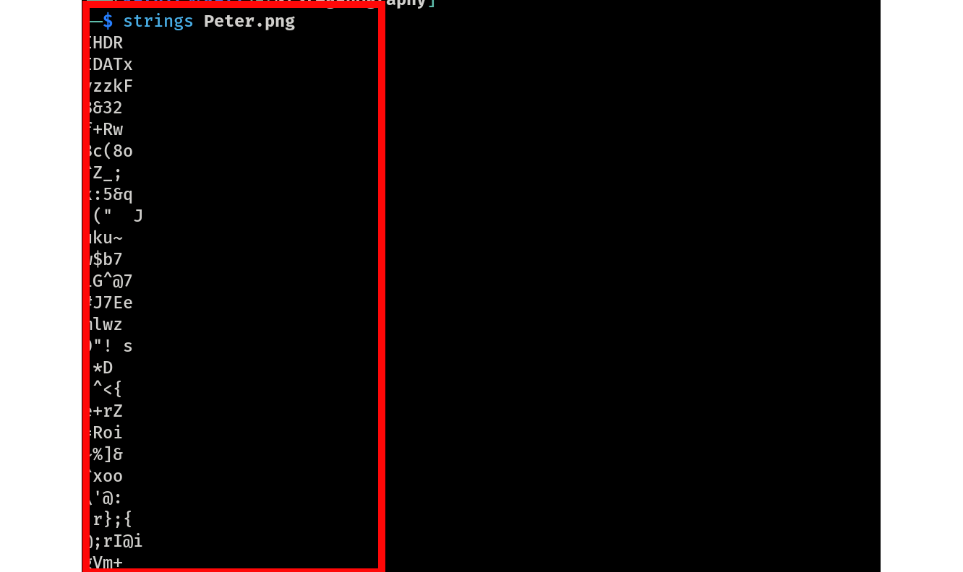
Steganography techniques found

Slide 17

Steganography techniques found in Faraz directory
While analyzing Faraz’s user directory from the disk image
Investigators discovered suspicious image files
One image was confirmed to contain hidden SPII (SSNs and employee data) using steganographic techniques
This immediately raised concern:
Why was sensitive HR data embedded inside media files?
Who had access to both HR data and stego tools?
To confirm how and when the data was accessed:
The team began reviewing authentication logs (/var/log/auth.log)
Auth log review focused on:
Sudo sessions
User switches (su)
Access timestamps to /home/hrmanager

Slide 18
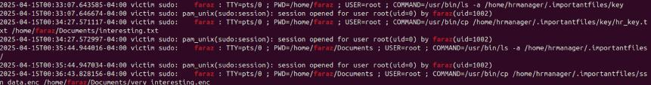
Privilege escalation
Encryption key extraction
Encrypted file extraction
Decryption

Slide 19

Phishing Email Never reported: A Turning Point in the Case
During the investigation, a phishing email was found in Faraz’s inbox:
Received from alerts@coinbbase.com (typo squatted domain)
Posed as a security alert from Coinbase
Faraz never reported this email to the security team
Contained a link to a fake website with threatening instructions to Faraz
This became a critical red flag:
Showed lack of compliance with phishing awareness protocols
Suggested possible cooperation or intentional negligence
The email became a key pivot point in shifting Faraz's role from victim to potential insider

Slide 20
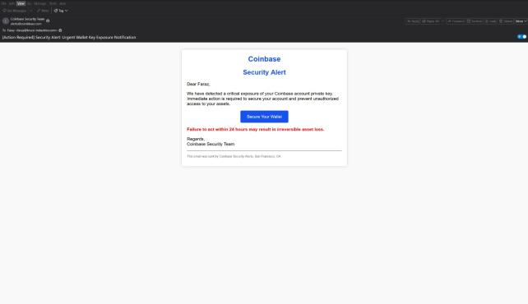
Initial mail received from Coinbase

Slide 21

A fake Coinbase-branded webpage
Demands to follow future instructions, including vulnerability injection
The phishing email included a link to: https://www.coinbbase.com-security-alerts.com/
To avoid interaction with a live malicious server, the team used a safe, automated screenshot tool to analyze the link's destination
The screenshot revealed
A threatening message directed at Faraz
This confirmed that the email was part of a coercive phishing campaign, contributing to Faraz’s compromised behavior

Slide 22
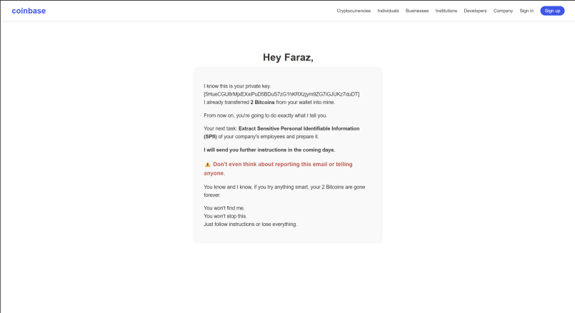

The message for Faraz is

Slide 23
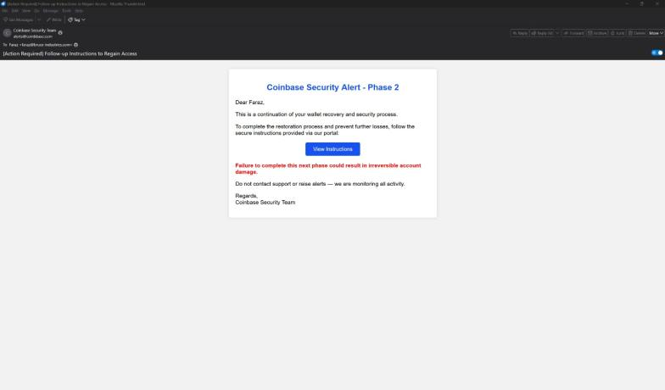
Second phishing mail

Slide 24
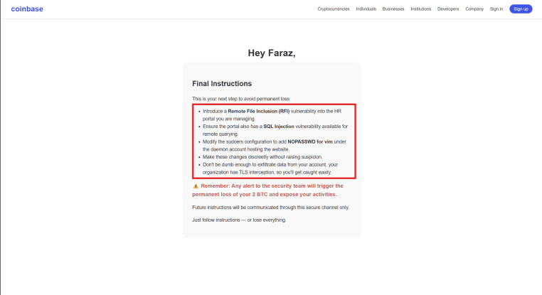
Instructions given in second mail

Slide 25
After the first phishing email, Faraz:
Accessed sensitive HR data
Transferred it into his own user account
Attempted to hide it using steganography techniques
However, due to the organization’s TLS interception, Faraz realized:
His traffic could be monitored
Direct data exfiltration from his account would expose him as an insider
Shortly after the second phishing email, his behavior changed:
Timeline aligned perfectly with these events
Stopped using his account for further actions
Followed the attacker’s next set of instructions
Planted vulnerabilities (SQLi, RFI) in the HR portal
Modified sudoers to allow NOPASSWD privilege escalation for the daemon user
Acted more like a facilitator, not a direct exfiltrator
It was unknown who was the one instructing Faraz...yet

Slide 26


Final Remarks
Faraz received a malicious email which was not reported
Evidence shows Faraz intentionally vandalized the HR portal
Allowed for an unauthorized individual to export sensitive information
It was unknown who was the one instructing Faraz...yet

Slide 27

Disclosure
CISO seized 1 bitcoin of Faraz as a Penalty
After the investigation is complete, the CISO reveals the incident was a controlled simulation
TLS interception resulted in unintentional decryption of Faraz's Coinbase wallet
CISO saw this as a training opportunity
Assess the teams under real pressure and psychological stress, also to assess the effectiveness of Forensics team.

Slide 28

Faraz was not harmed during this project (I was)
Thanks Prof. Dominic Sellitto, CISSP for providing two Virtual Machines
.

Slide 29

Thank You
Let us know if you have any questions!!!

